Slide 1
Chapter 6 Kernel Smoothing Methods
-Zhang Yuxin

Slide 2
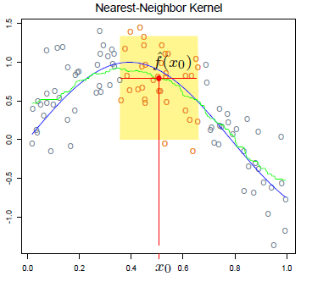

One-Dimensional Kernel Smoothers
Review the K-nearest-neighbor average method in Chapter 2
Use the 30-nearest neighborhood

Slide 3



An example
Nadaraya-Watson kernel-weighted average
Nadaraya-Watson
kernel-weighted average
with the Epanechnikov quadratic kernel
with

Slide 4
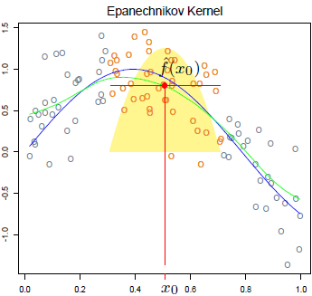
Continuous and quite smooth.
An Epanechnikov kernel with (half ) window width λ= 0.2

Slide 5
Kernel - Definition
A Kernel K(., .), function of two variables, is an inner product of two vectors that are the image of the two variables under a feature mapping
Inner product is related to a norm (metric)
A kernel can be represented as a decreasing function of a distance between the two objects
a measure of similarity between two objects

Slide 6
Kernels with One-dimensional Features
D: a decreasing function on R⁺
h_{λ}(.):
a window with some specified width
a scaling function on R

Slide 7
Some kinds of kernel
Name | D(t) | hλ | Compact or not
Uniform kernel |  |  | Yes
Epanecnikov Quadratic Kernel |  |  | Yes
Tri-Cube Kernel |  |  | Yes
Gaussian Kernel |  |  | Not

Slide 8
There are a number of details that one has to attend to in practice:
Large λ implies lower variance but higher bias.
Metric window widths (constant h λ(x))
keep the bias of the estimate constant but the variance is inversely proportional to the local density.
Nearest-neighbor window
the variance stays constant and the absolute bias varies inversely with local density.

Slide 9

When there are ties in the xi.
observation weights wi. Operationally we simply multiply them by the kernel weights before computing the weighted average.
Boundary issues arise. The metric neighborhoods tend to contain less points on the boundaries, while the nearest-neighborhoods get wider.
The Epanechnikov kernel has compact support (needed when used with nearest-neighbor window size). Another popular compact kernel is based on the tri-cube function

Slide 10
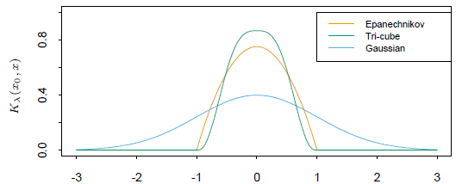
This is flatter on the top (like the nearest-neighbor box) and is differentiable at the boundary of its support. The Gaussian density function D(t) = Ф(t) is a popular noncompact kernel, with the standard deviation playing the role of the window size.

Slide 11
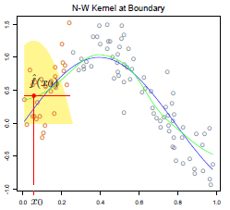
The smooth kernel fit still has problems:
Locally-weighted averages can be badly biased on the boundaries of the domain, because of the asymmetry of the kernel in that region.

Slide 12
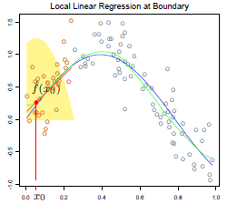
By fitting straight lines rather than constants locally, we can remove this bias exactly to first order
Locally weighted regression

Slide 13


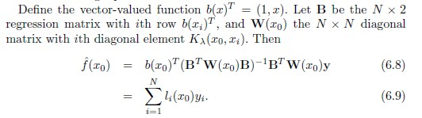
Locally weighted regression

Slide 14
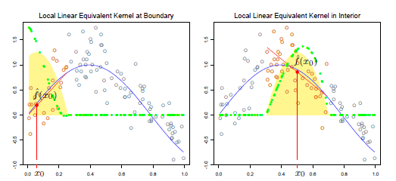
The equivalent kernel li(x0) for local regression

Slide 15
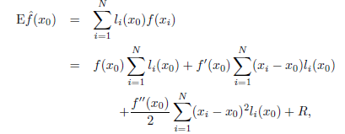

Consider the following expansion
for local linear regression

Slide 16

Local Polynomial Regression
We can fit local polynomial fits of any degree d
the bias will only have components of degree d+1 and higher
increased variance is a price to be paid for this bias reduction

Slide 17
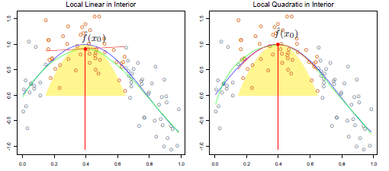
An example

Slide 18
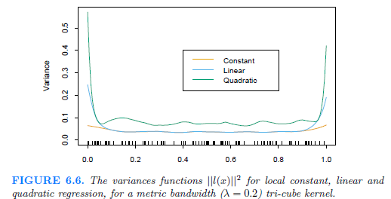
Local linear fits can help bias dramatically at the boundaries at a modest cost in variance. Local quadratic fits do little at the boundaries for bias, but increase the variance a lot.

Slide 19
Selecting the Width of the Kernel

Slide 20


Local Regression in IR^{P}
Let b(X) be a vector of polynomial terms in X of maximum degree d.

Slide 21
Boundary effects are a much bigger problem in two or higher dimensions, since the fraction of points on the boundary is larger.
Local regression becomes less useful in dimensions much higher than two or three.
It is impossible to simultaneously maintain localness (=>low bias) and a sizable sample in the neighborhood (=>low variance) as the dimension increases, without the total sample size increasing exponentially in p.

Slide 22
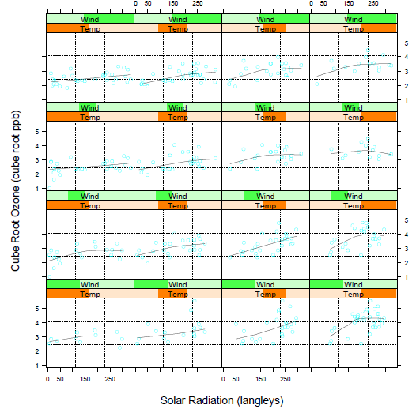
it is probably more useful in terms of understanding the joint behavior of the data.

Slide 23

Structured Local Regression Models in IR^{P}
Structured Kernels
standardize each variable to unit standard deviation
use a positive semidefinite matrix A to weigh the different coordinates:

Slide 24


Structured Regression Functions
We are trying to fit a regression function E(Y︱X) = f(X1;X2; : : : ;Xp) in IRp, in which every level of interaction is potentially present.
Analysis-of-variance (ANOVA) decompositions
varying coefficient models
Suppose, for example, that we divide the p predictors in X into a set (X1;X2; : : : ;Xq) with q < p, and the remainder of the variables we collect in the vector Z. We then assume the conditionally linear model
For given Z, this is a linear model, but each of the coefficients can vary with Z. It is natural to fit such a model by locally weighted least squares:

Slide 25
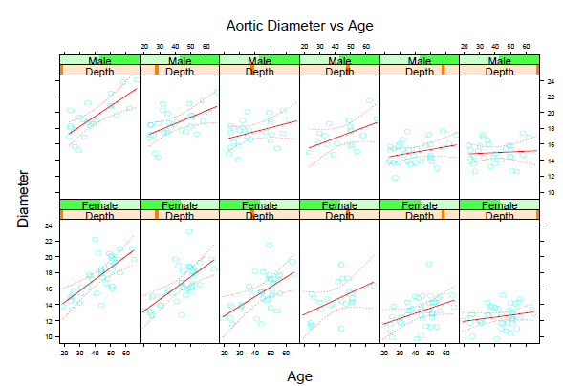
Here we model the diameter of the aorta as a linear function of age, but allow the coefficients to vary with gender and depth down the aorta. We used a local regression model separately for males and females.

Slide 26
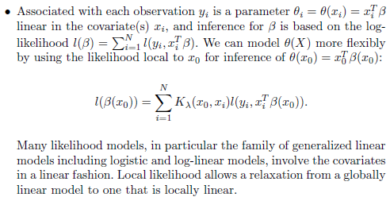
Local Likelihood and Other Models

Slide 27
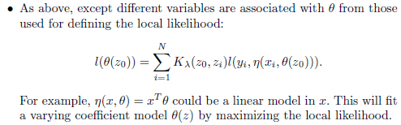
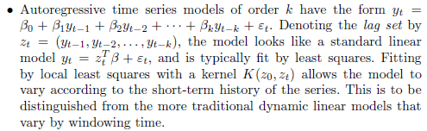
Time Series Analysis?

Slide 28


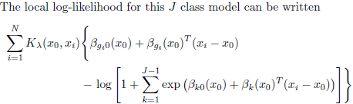
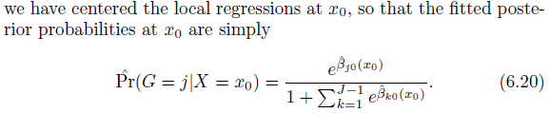

Slide 29




Kernel Density Estimation and Classification
Kernel Density Estimation
Parzen estimate
In this case a popular choice for Kλ¸ is the Gaussian kernel
Letting Фλ¸ denote the Gaussian density with mean zero and standard-deviation λ,
then
In IR^{P} the natural generalization of the Gaussian density estimate amounts to using the Gaussian product kernel

Slide 30

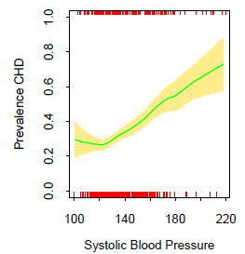
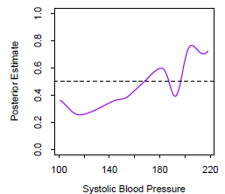
Kernel Density Classification
Use nonparametric density estimates for classification in a straightforward fashion using Bayes' theorem.

Slide 31



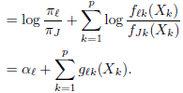
The Naive Bayes Classifier
The naive Bayes model assumes that given a class G = j, the features Xk are independent:
we can derive the logit-transform (using class J as the base):

Slide 32
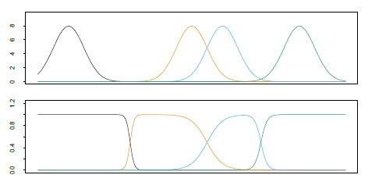



Radial Basis Functions and Kernels
Functions can be represented as expansions in basis functions:
Treating the kernel functions Kλ(ξ ,x) as basis functions.
standard Gaussian density function.
There are several approaches to learning the parameters {ξ j, λj, βj}, j = 1,…,M. For simplicity we will focus on least squares methods for regression, and use the Gaussian kernel.
While it would seem attractive to reduce the parameter set and assume a constant value for λj = λ, this can have an undesirable side effect of creating holes-regions of IR^{P} where none of the kernels has appreciable support.
Renormalized radial basis functions,
avoid this problem

Slide 33
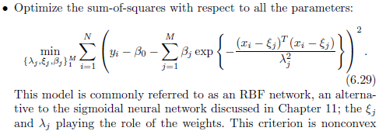

Given the former, the estimation of the latter is a simple least squares problem. Often the kernel parameters λj and ξj are chosen in an unsupervised way using the X distribution alone.
An example
The Nadaraya{Watson kernel regression estimator in IR^{P} can be viewed as an expansion in renormalized radial basis functions,

Slide 34


Mixture Models for Density Estimation and Classification
The Gaussian mixture model has the form
(6.32)
with
The parameters are usually fit by maximum likelihood, using the EM algorithm
If in addition σm = σ > 0 is fixed, and M↑N, then the maximum likelihood estimate for (6.32) approaches the kernel density estimate (6.22) where = 1=N and = xm.
The mixture model also provides an estimate of the probability that observation i belongs to component m,

Slide 35

An example
Figure 6.17 shows an application of mixtures to the heart disease riskfactor study.
Fit a two-component mixture of the form (6.32) with the (scalars) ∑ 1 and ∑ 2 not constrained to be equal.

Slide 36
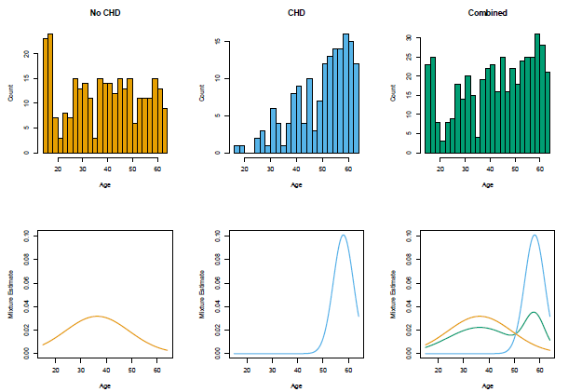

Slide 37
Thanks!

